Slide 1


UNIVERSITY INSTITUTE OF ENGINEERING
COMPUTER SCIENCE ENGINEERING
Bachelor of Engineering (Computer Science & Engineering)
Subject Name: Cloud Computing & Distributed Systems
Subject Code: 21CST-378/21ITT-378
DISCOVER . LEARN . EMPOWER

Slide 2
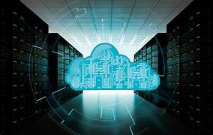
Cloud Computing & Distributed Systems
Course Outcomes
CO1: Understanding of various paradigm of cloud computing and distributed systems.
CO2: Articulate the basic concepts, key technologies, strength and limitation of cloud computing and possible applications.
CO3: Appraise the architecture and infrastructure of cloud computing including SaaS, PaaS, IaaS, UCaaS/FaaS public cloud, private cloud and hybrid cloud.
CO4: Interpret various data, scalability, security and cloud services to acquire efficient database for cloud storage.
CO5: Develop the appropriate cloud computing solutions and recommendations according to the application used.

Slide 3
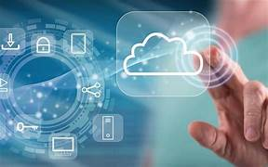
Cloud Computing & Distributed Systems
Contents
Introduction to Distributed System
Examples of distributed systems
Trends in distributed Systems
Types of System Models: Physical models
Architectural models
Fundamental models

Slide 4
Cloud Computing & Distributed Systems
UNIT 1
INTRODUCTION TO CLOUD COMPUTING AND DISTRIBUTED SYSTEMS
CHAPTER 1
DISTRIBUTED SYSTEMS

Slide 5
Introduction to Distributed Systems (CO1)
Distributed System is a collection of autonomous computer systems that are physically separated but are connected by a centralized computer network that is equipped with distributed system software. The autonomous computers will communicate among each system by sharing resources and files and performing the tasks assigned to them.

Slide 6
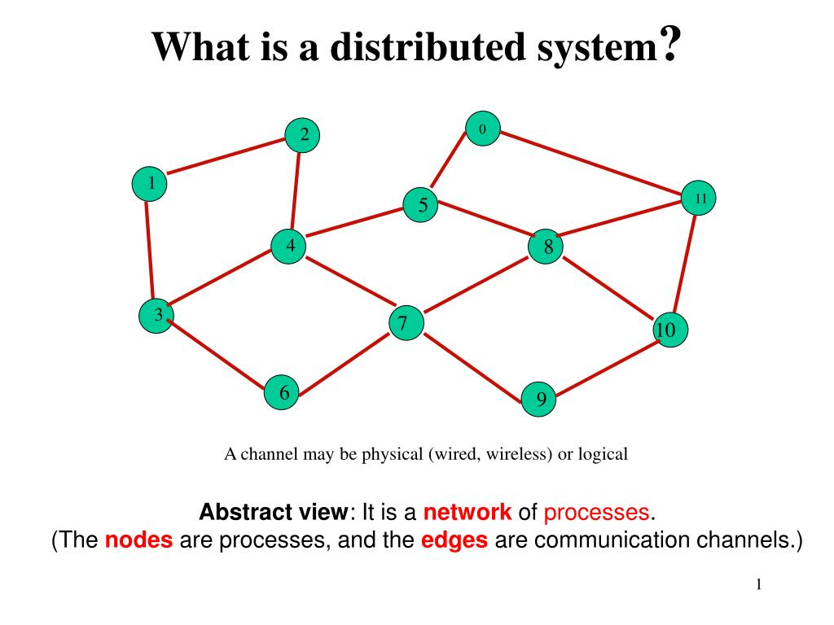

Slide 7
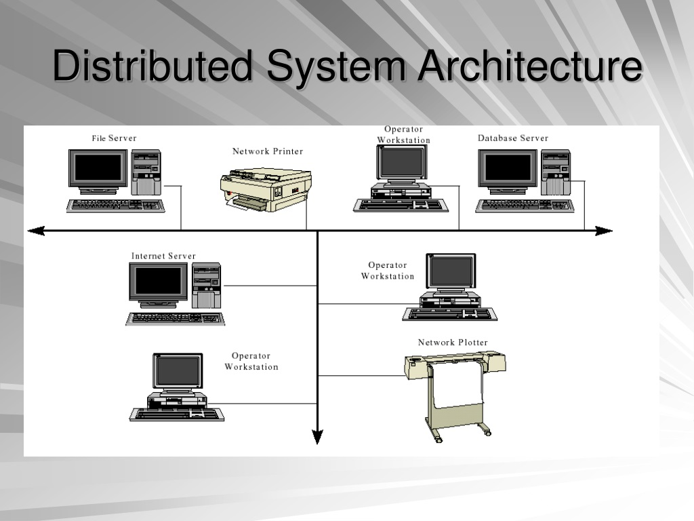

Slide 8
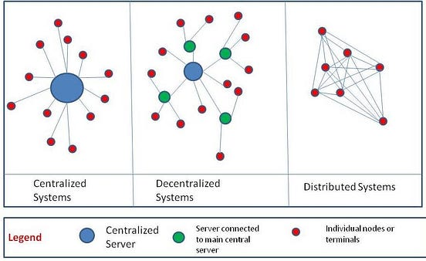

Slide 9
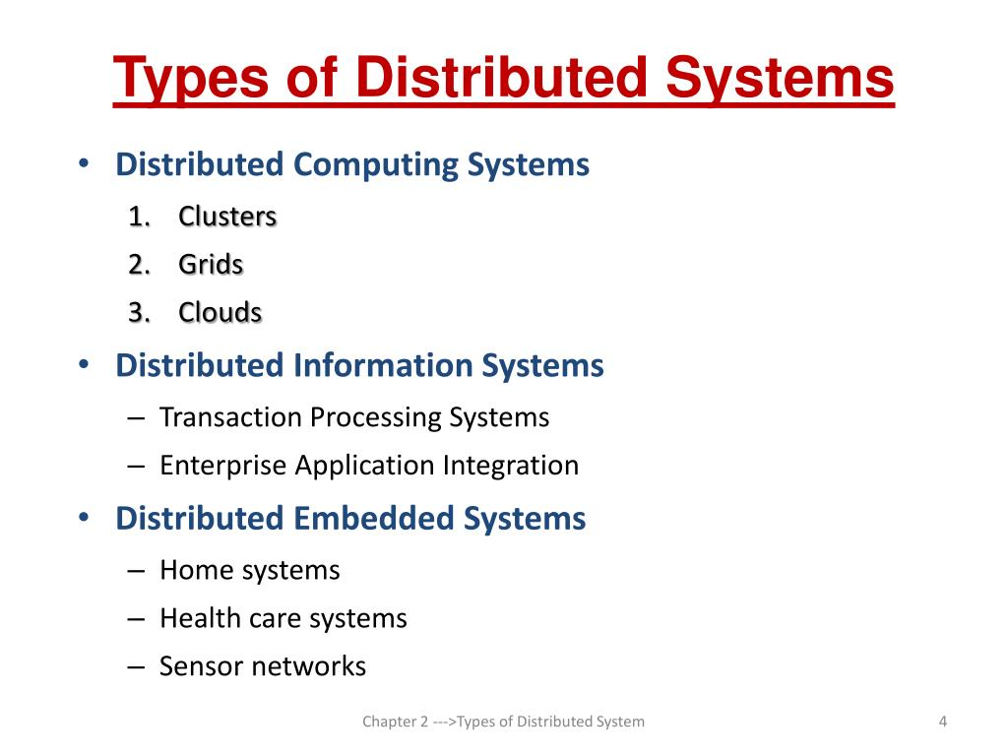

Slide 10
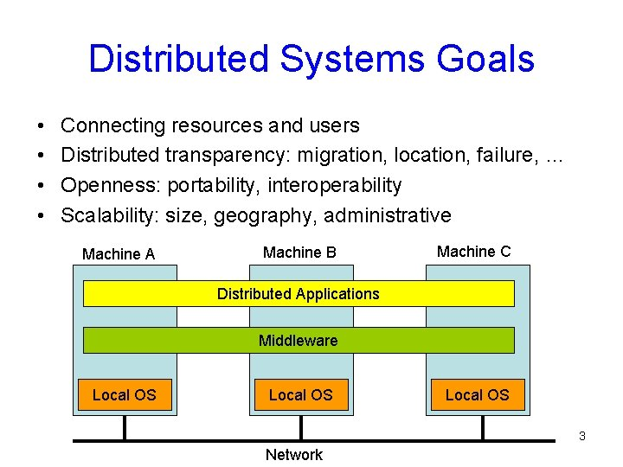

Slide 11
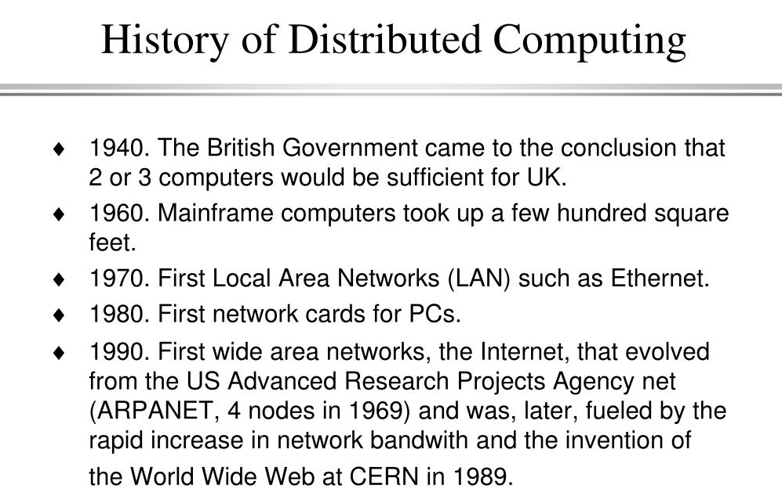

Slide 12
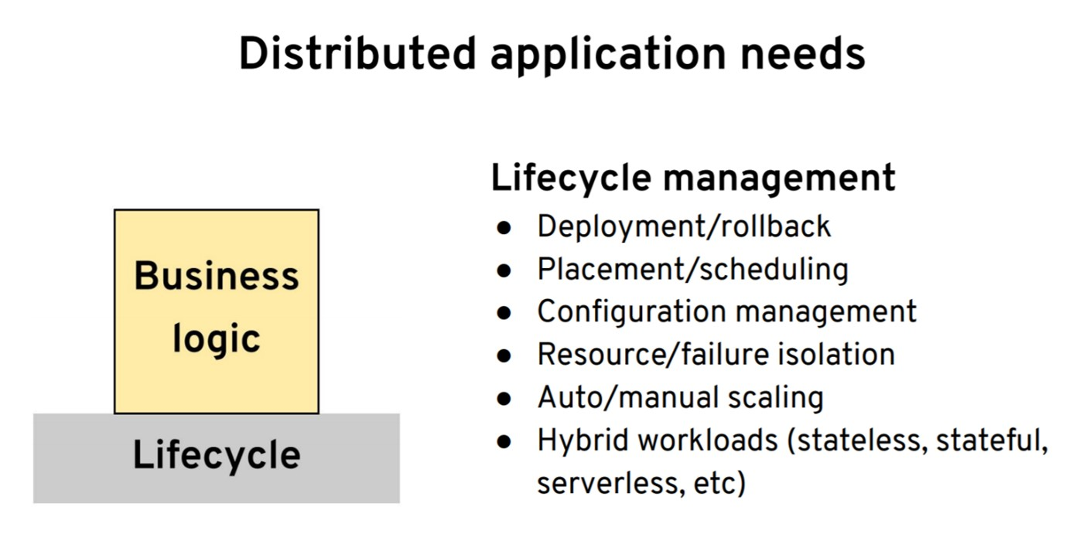

Slide 13
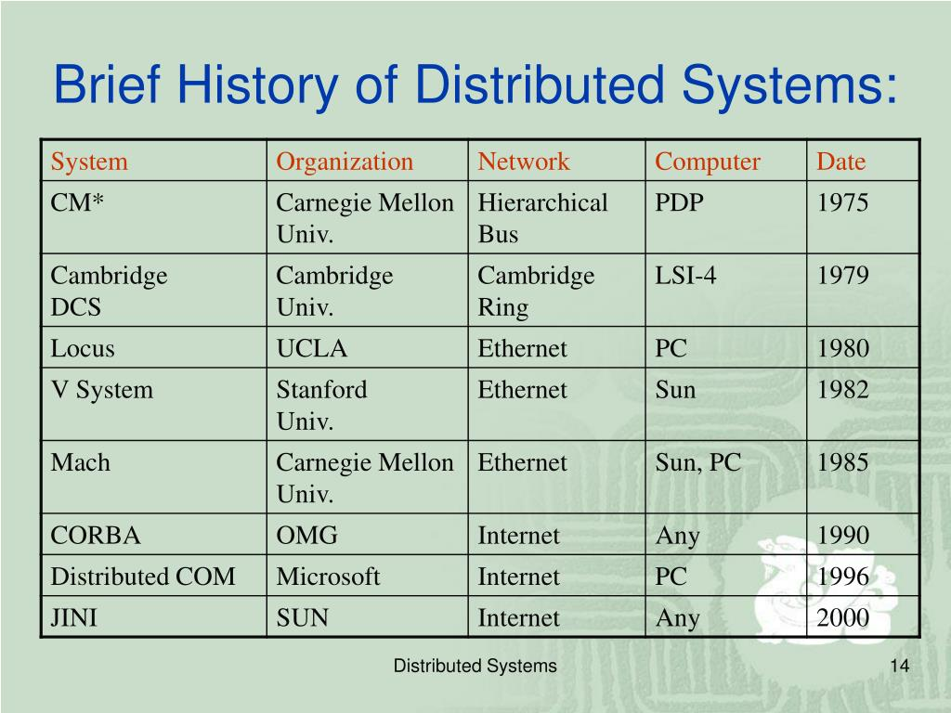

Slide 14
Key Characteristics of Distributed Systems:
Scalability: Ability to handle an increasing number of users or tasks by adding resources.
2. Fault Tolerance: System's ability to continue operating despite failures or faults in some of its components.
3. Heterogeneity: Involves the use of diverse hardware, software, and network platforms.
4. Concurrency: Multiple components working simultaneously to accomplish tasks.

Slide 15
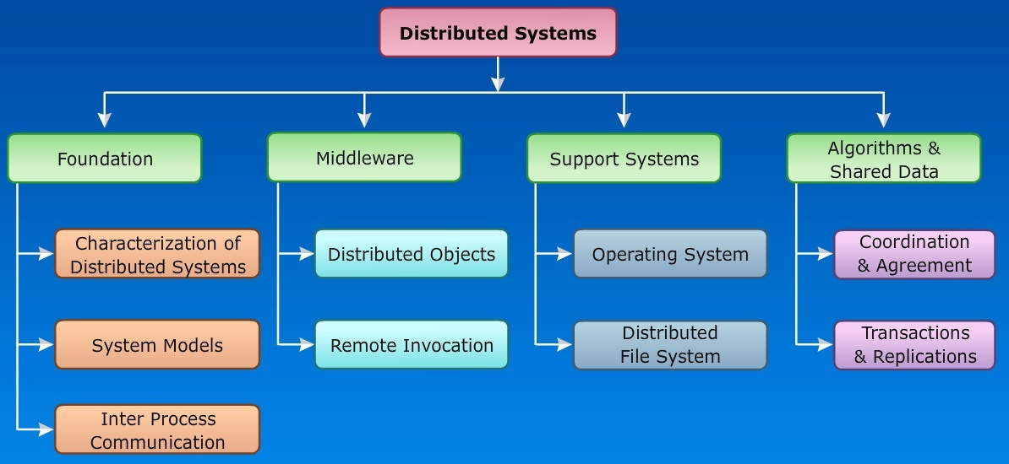

Slide 16
ADVANTAGES OF DISTRIBUTED SYSTEMS
Resource Sharing: Efficient utilization of resources across the network.
2. Reliability: Increased system reliability through redundancy and fault tolerance.
3. Performance Improvement: Enhanced performance by distributing the workload.
4. Flexibility and Extensibility: Easy expansion and adaptation to changing requirements.

Slide 17
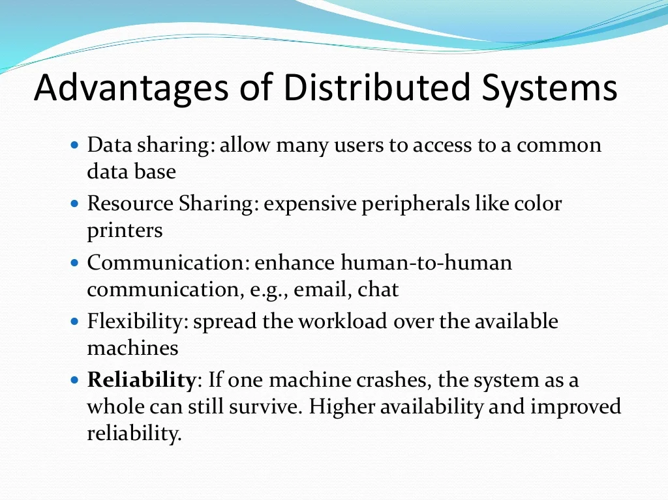

Slide 18
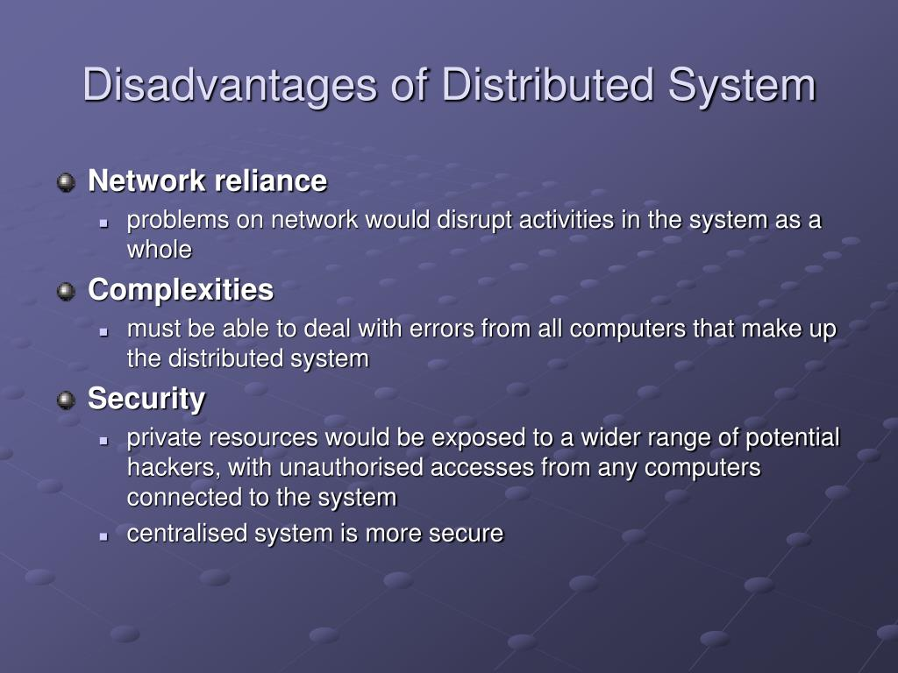

Slide 19
Challenges in Distributed Systems
Communication Delays: Latency in communication between distributed components.
2. Consistency: Ensuring data consistency across multiple nodes.
3. Fault Detection and Recovery: Identifying and recovering from system failures.
4. Security and Privacy: Addressing concerns related to data security and privacy.

Slide 20
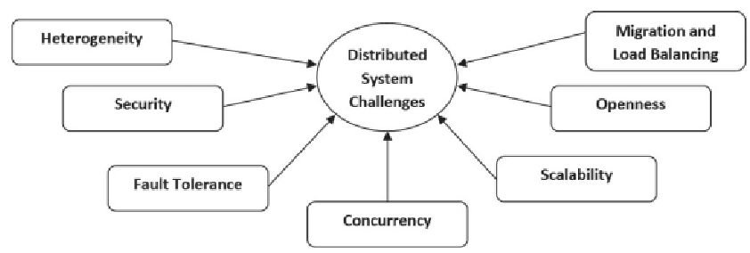

Slide 21
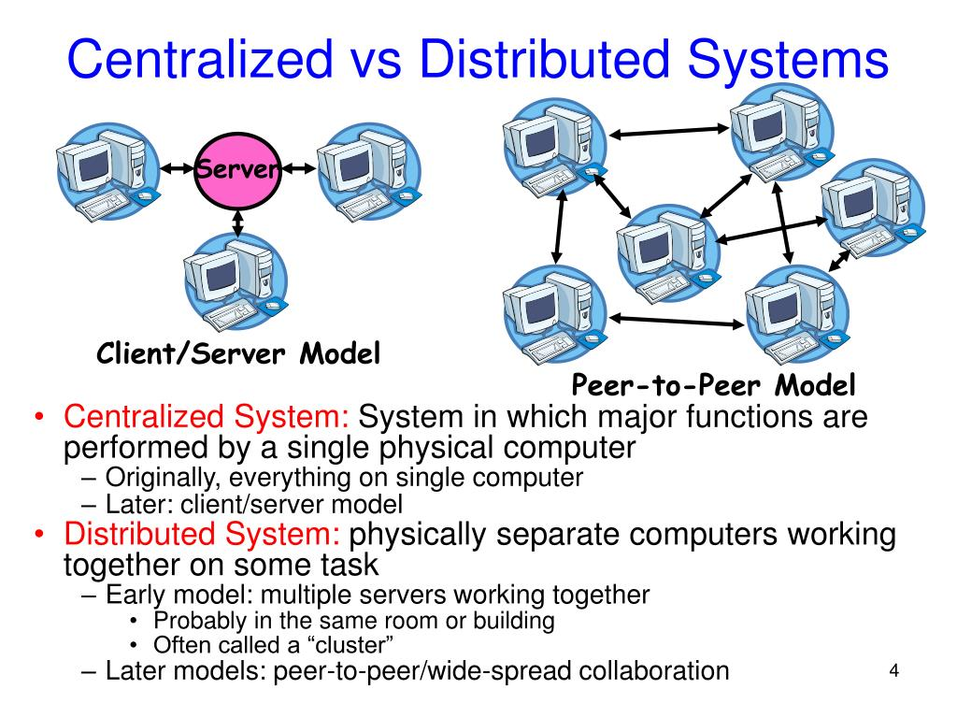

Slide 22
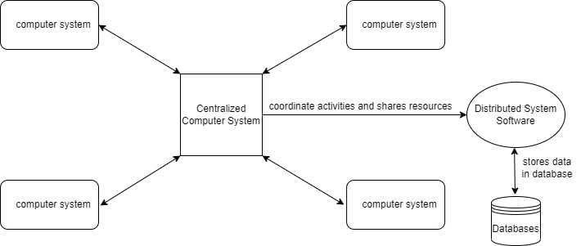
Examples of Distributed Systems (CO-1)
Any Social Media can have its Centralized Computer Network as its Headquarters and computer systems that can be accessed by any user and using their services will be the Autonomous Systems in the Distributed System Architecture.

Slide 23
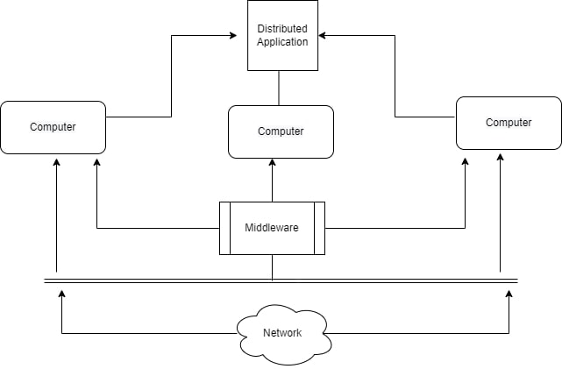

Slide 24
1. Distributed System Software: This Software enables computers to coordinate their activities and to share the resources such as Hardware, Software, Data, etc.
2. Database: It is used to store the processed data that are processed by each Node/System of the Distributed systems that are connected to the Centralized network.
3. As we can see that each Autonomous System has a common Application that can have its own data that is shared by the Centralized Database System.
4. To Transfer the Data to Autonomous Systems, Centralized System should be having a Middleware Service and should be connected to a Network.
5. Middleware Services enable some services which are not present in the local systems or centralized system default by acting as an interface between the Centralized System and the local systems. By using components of Middleware Services systems communicate and manage data.
6. The Data which is been transferred through the database will be divided into segments or modules and shared with Autonomous systems for processing.
7. The Data will be processed and then will be transferred to the Centralized system through the network and will be stored in the database.

Slide 25
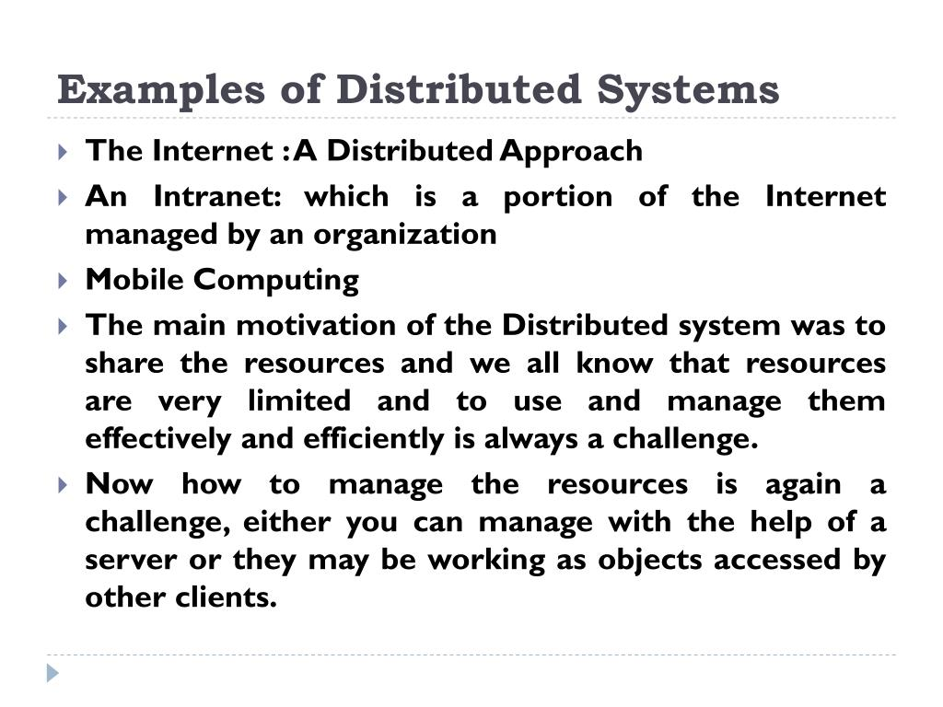

Slide 26
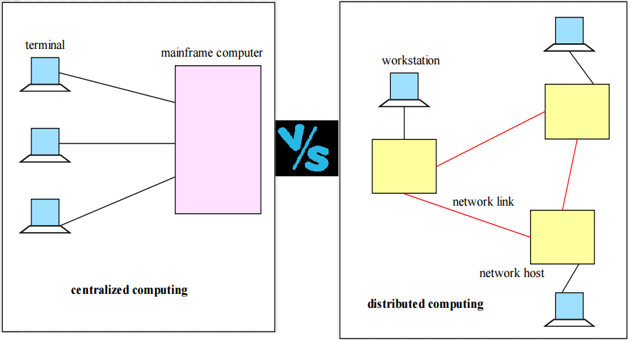

Slide 27
Applications Area of Distributed System
Finance and Commerce: Amazon, eBay, Online Banking, E-Commerce websites.
2. Information Society: Search Engines, Wikipedia, Social Networking, Cloud Computing.
3. Cloud Technologies: AWS, Salesforce, Microsoft Azure, SAP.
4. Entertainment: Online Gaming, Music, youtube.
5. Healthcare: Online patient records, Health Informatics.
6. Education: E-learning.
7. Transport and logistics: GPS, Google Maps.
8. Environment Management: Sensor technologies.

Slide 28
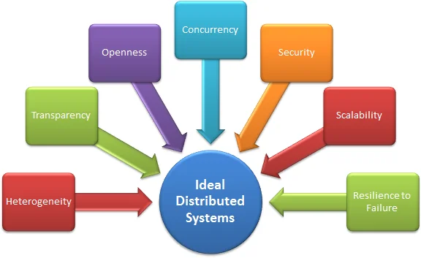

Slide 29
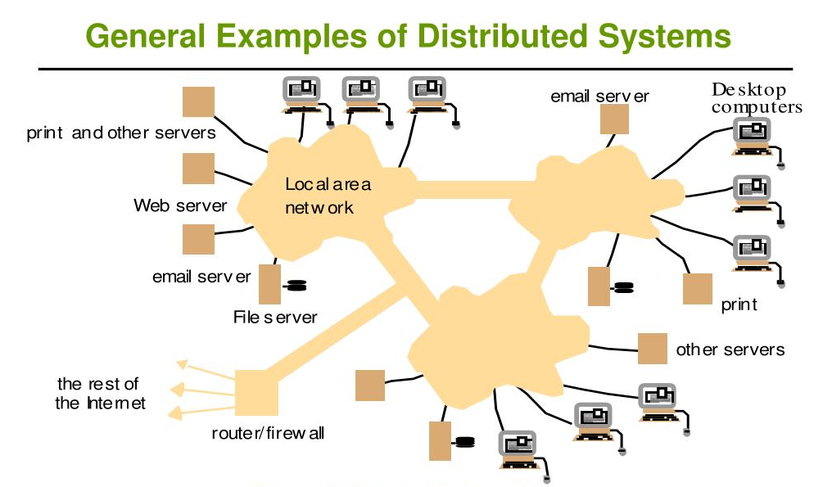

Slide 30
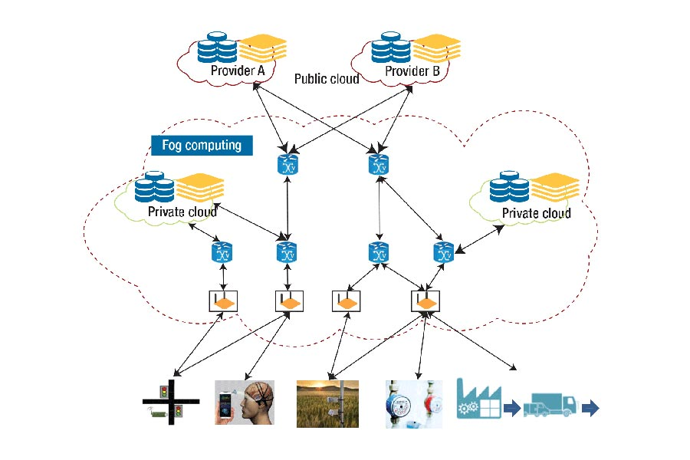

Slide 31
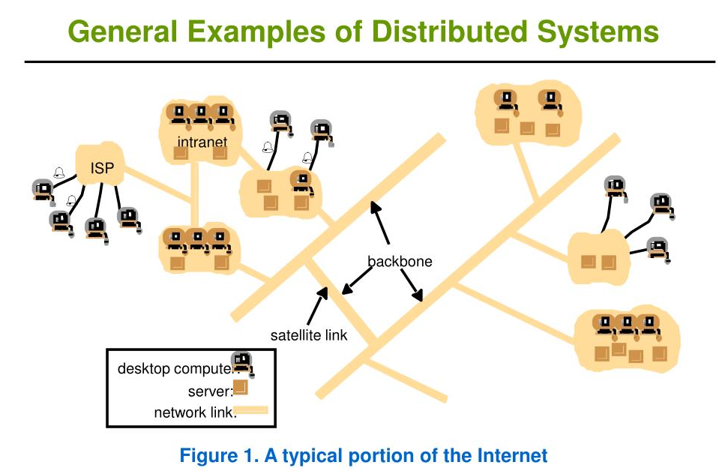

Slide 32
Trends in Distributed Systems (CO-1)
Distributed systems are undergoing a period of significant change and this can be traced back to a number of influential trends:
1. The emergence of pervasive networking technology
2. The emergence of ubiquitous computing coupled with the desire to support user mobility in distributed systems
3. The increasing demand for multimedia services
4. The view of distributed systems as a utility

Slide 33
Internet
The modern Internet is a vast interconnected collection of computer networks of many different types, with the range of types increasing all the time and now including, for example, a wide range of wireless communication technologies such as WiFi, WiMAX, Bluetooth and third-generation mobile phone networks. The net result is that networking has become a pervasive resource and devices can be connected (if desired) at any time and in any place.
The Internet is also a very large distributed system. It enables users, wherever they are, to make use of services such as the World Wide Web, email and file transfer. (Indeed, the Web is sometimes incorrectly equated with the Internet.) The set of services is open-ended – it can be extended by the addition of server computers and new types of service. The figure shows a collection of intranets – subnetworks operated by companies and other organizations and typically protected by firewalls. The role of a firewall is to protect an intranet by preventing unauthorized messages from leaving or entering. A firewall is implemented by filtering incoming and outgoing messages. Filtering might be done by source or destination, or a firewall might allow only those messages related to email and web access to pass into or out of the intranet that it protects. Internet Service Providers (ISPs) are companies that provide broadband links and other types of connection to individual users and small organizations, enabling them to access services anywhere in the Internet as well as providing local services such as email and web hosting. The intranets are linked together by backbones. A backbone is a network link with a high transmission capacity, employing satellite connections, fibre optic cables and other high-bandwidth circuits

Slide 34
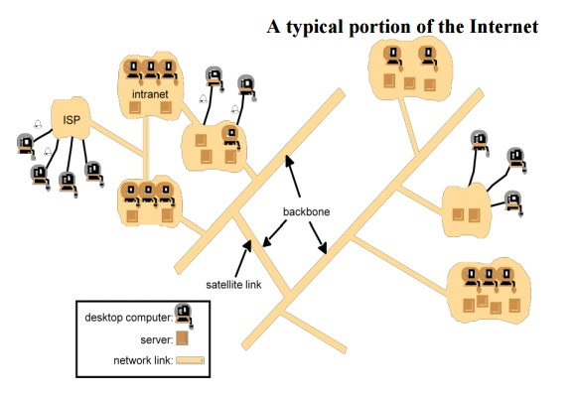

Slide 35
Mobile and ubiquitous computing
Technological advances in device miniaturization and wireless networking have led increasingly to the integration of small and portable computing devices into distributed systems. These devices include:
Laptop computers.
Handheld devices, including mobile phones, smart phones, GPS-enabled devices, pagers, personal digital assistants (PDAs), video cameras and digital cameras.
Wearable devices, such as smart watches with functionality similar to a PDA.
Devices embedded in appliances such as washing machines, hi-fi systems, cars and refrigerators.
The portability of many of these devices, together with their ability to connect conveniently to networks in different places, makes mobile computing possible. Mobile computing is the performance of computing tasks while the user is on the move, or visiting places other than their usual environment. In mobile computing, users who are away from their ‘home’ intranet (the intranet at work, or their residence) are still provided with access to resources via the devices they carry with them. They can continue to access the Internet; they can continue to access resources in their home intranet; and there is increasing provision for users to utilize resources such as printers or even sales points that are conveniently nearby as they move around. The latter is also known as location-aware or context-aware computing. Mobility introduces a number of challenges for distributed systems, including the need to deal with variable connectivity and indeed disconnection, and the need to maintain operation in the face of device mobility.
Ubiquitous computing is the harnessing of many small, cheap computational devices that are present in users’ physical environments, including the home, office and even natural settings. The term ‘ubiquitous’ is intended to suggest that small computing devices will eventually become so pervasive in everyday objects that they are scarcely noticed. That is, their computational behaviour will be transparently and intimately tied up with their physical function.
The presence of computers everywhere only becomes useful when they can communicate with one another. For example, it may be convenient for users to control their washing machine or their entertainment system from their phone or a ‘universal remote control’ device in the home. Equally, the washing machine could notify the user via a smart badge or phone when the washing is done.
Ubiquitous and mobile computing overlap, since the mobile user can in principle benefit from computers that are everywhere. But they are distinct, in general. Ubiquitous computing could benefit users while they remain in a single environment such as the home or a hospital. Similarly, mobile computing has advantages even if it involves only conventional, discrete computers and devices such as laptops and printers.

Slide 36
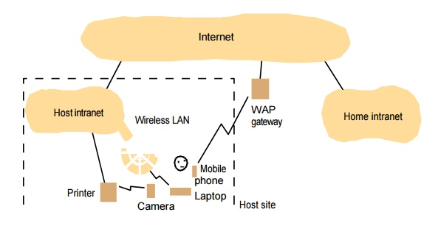

Slide 37
Distributed Multimedia Systems
With the increasing maturity of distributed systems infrastructure, a number of companies are promoting the view of distributed resources as a commodity or utility, drawing the analogy between distributed resources and other utilities such as water or electricity. With this model, resources are provided by appropriate service suppliers and effectively rented rather than owned by the end user. This model applies to both physical resources and more logical services

Slide 38
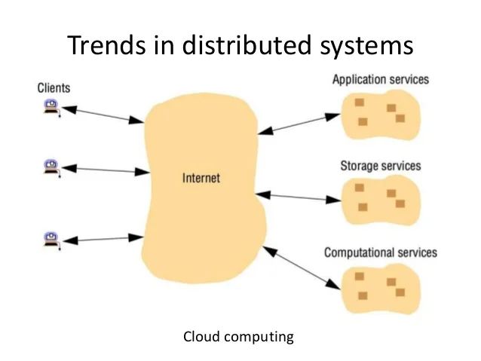

Slide 39
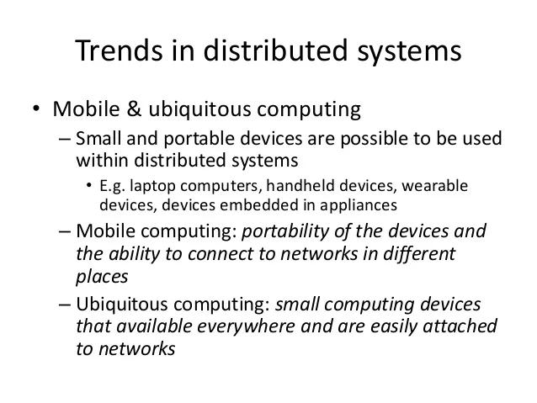

Slide 40
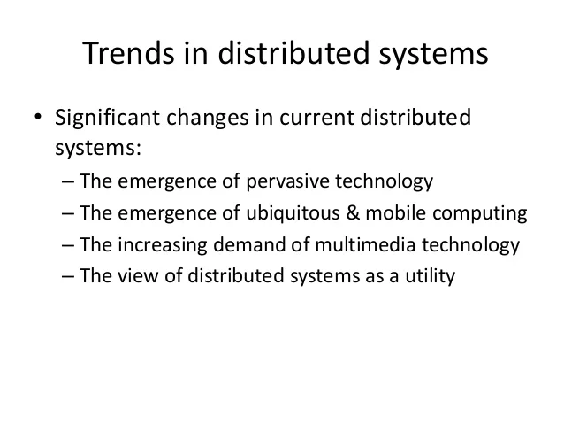

Slide 41
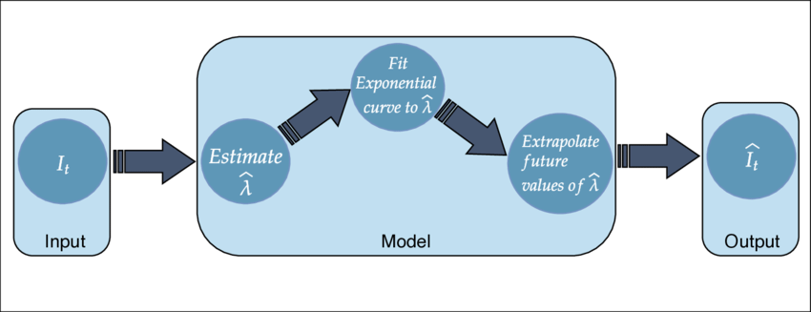
Types of System Models: Physical models, Architectural models & Fundamental models (CO-1)
A physical model is a representation of the underlying hardware elements of a distributed system that abstracts away from specific details of the computer and networking technologies employed
1. Baseline physical model: A distributed system is one in which hardware or software components located at networked computers communicate and coordinate their actions only by passing messages. This leads to a minimal physical model of a distributed system as an extensible set of computer nodes interconnected by a computer network for the required passing of messages.
Beyond this baseline model, we can usefully identify three generations of distributed systems.

Slide 42
2. Early distributed systems: Such systems emerged in the late 1970s and early 1980s in response to the emergence of local area networking technology, usually Ethernet These systems typically consisted of between 10 and 100 nodes interconnected by a local area network, with limited Internet connectivity and supported a small range of services such as shared local printers and file servers as well as email and file transfer across the Internet. Individual systems were largely homogeneous and openness was not a primary concern. Providing quality of service was still very much in its infancy and was a focal point for much of the research around such early systems.
3. Contemporary distributed systems: In the above systems, nodes were typically desktop computers and therefore relatively static (that is, remaining in one physical location for extended periods), discrete (not embedded within other physical entities) and autonomous (to a large extent independent of other computers in terms of their physical infrastructure) The emergence of mobile computing has led to physical models where nodes such as laptops or smartphones may move from location to location in a distributed system, leading to the need for added capabilities such as service discovery and support for spontaneous interoperation. The emergence of ubiquitous computing has led to a move from discrete nodes to architectures where computers are embedded in everyday objects and in the surrounding environment
The emergence of cloud computing and, in particular, cluster architectures has led to a move from autonomous nodes performing a given role to pools of nodes that together provide a given service (for example, a search service as offered by Google)

Slide 43
4. Internet-scale distributed systems: Building on this foundation, larger-scale distributed systems started to emerge in the 1990s in response to the dramatic growth of the Internet during this time (for example, the Google search engine was first launched in 1996). In such systems, the underlying physical infrastructure consists of a physical model that is, an extensible set of nodes interconnected by a network of networks (the Internet). Such systems exploit the infrastructure offered by the Internet to become truly global.
They incorporate large numbers of nodes and provide distributed system services for global organizations and across organizational boundaries. The level of heterogeneity in such systems is significant in terms of networks, computer architecture, operating systems, languages employed and the development teams involved. This has led to an increasing emphasis on open standards and associated middleware technologies such as CORBA and more recently, web services. Additional services were employed to provide end-to-end quality of service properties in such global systems
5. Distributed systems of systems: A recent report discusses the emergence of ultra-large-scale (ULS) distributed systems. The report captures the complexity of modern distributed systems by referring to such (physical) architectures as systems of systems (mirroring the view of the Internet as a network of networks). A system of systems can be defined as a complex system consisting of a series of subsystems that are systems in their own right and that come together to perform a particular task or tasks

Slide 44
Architecture Styles in Distributed systems
Distributed systems are a set of autonomous computers that appears to be a single coherent system to its users from outside.
There are actually two different types of systems that exist in prospective of computers:
Centralized System :
1. A centralized system consists of a single machine.
2. All calculations are done by a particular computer.
3. Its performance is low as the workload is not divided.
4. There is also no machine present in backup if the original computer system fails.
Distributed Systems:
1. A distributed system consists of multiple machines.
2. All computation work is divided among the different systems.
3. Its performance is high as the workload is divided among different computers to efficiently use their capacity.
4. There are systems present in backup, so if the main system fails then work will not stop.

Slide 45
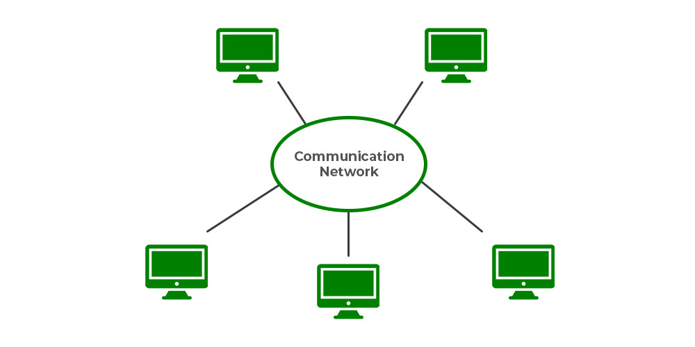

Slide 46
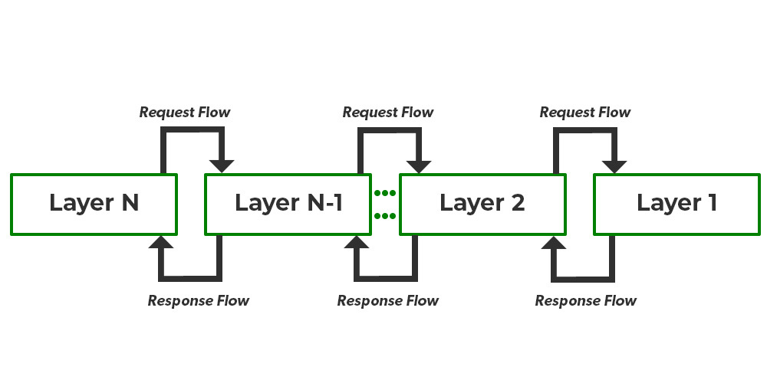
1. Layered Architecture:
In Layered architecture, different components are organized in layers. Each layer communicates with its adjacent layer by sending requests and getting responses. The layered architecture separates components into units. It is an efficient way of communication. Any layer can not directly communicate with another layer. A layer can only communicate with its neighboring layer and then the next layer transfers information to another layer and so on the process goes on.

Slide 47
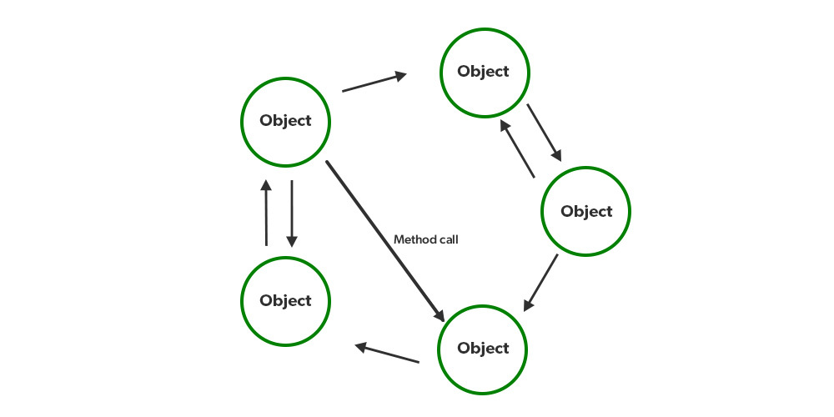
2. Object-Oriented Architecture:
In this type of architecture, components are treated as objects which convey information to each other. Object-Oriented Architecture contains an arrangement of loosely coupled objects. Objects can interact with each other through method calls. Objects are connected to each other through the Remote Procedure Call (RPC) mechanism or Remote Method Invocation (RMI) mechanism. Web Services and REST API are examples of object-oriented architecture. Invocations of methods are how objects communicate with one another. Typically, these are referred to as Remote Procedure Calls (RPC). REST API Calls, Web Services, and Java RMI are a few well-known examples. These characteristics apply to this.

Slide 48
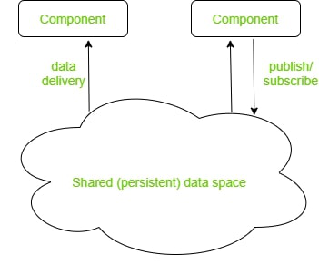
3. Data Centered Architecture:
Data Centered Architecture is a type of architecture in which a common data space is present at the centre. It contains all the required data in one place a shared data space. All the components are connected to this data space and they follow publish/subscribe type of communication. It has a central data repository at the centre. Required data is then delivered to the components. Distributed file systems, producer-consumer systems, and web-based data services are a few well-known examples.

Slide 49
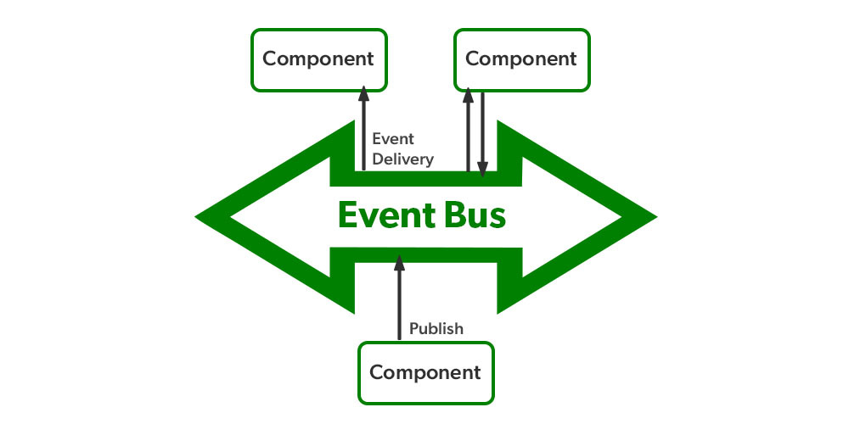
4. Event-Based Architecture:
Event-Based Architecture is almost similar to Data centered architecture just the difference is that in this architecture events are present instead of data. Events are present at the centre in the Event bus and delivered to the required component whenever needed. In this architecture, the entire communication is done through events. When an event occurs, the system, as well as the receiver, get notified. Data, URLs etc are transmitted through events. The components of this system are loosely coupled that’s why it is easy to add, remove and modify them. Heterogeneous components can communicate through the bus. One significant benefit is that these heterogeneous components can communicate with the bus using any protocol. However, a specific bus or an ESB has the ability to handle any kind of incoming request and respond appropriately.

Slide 50
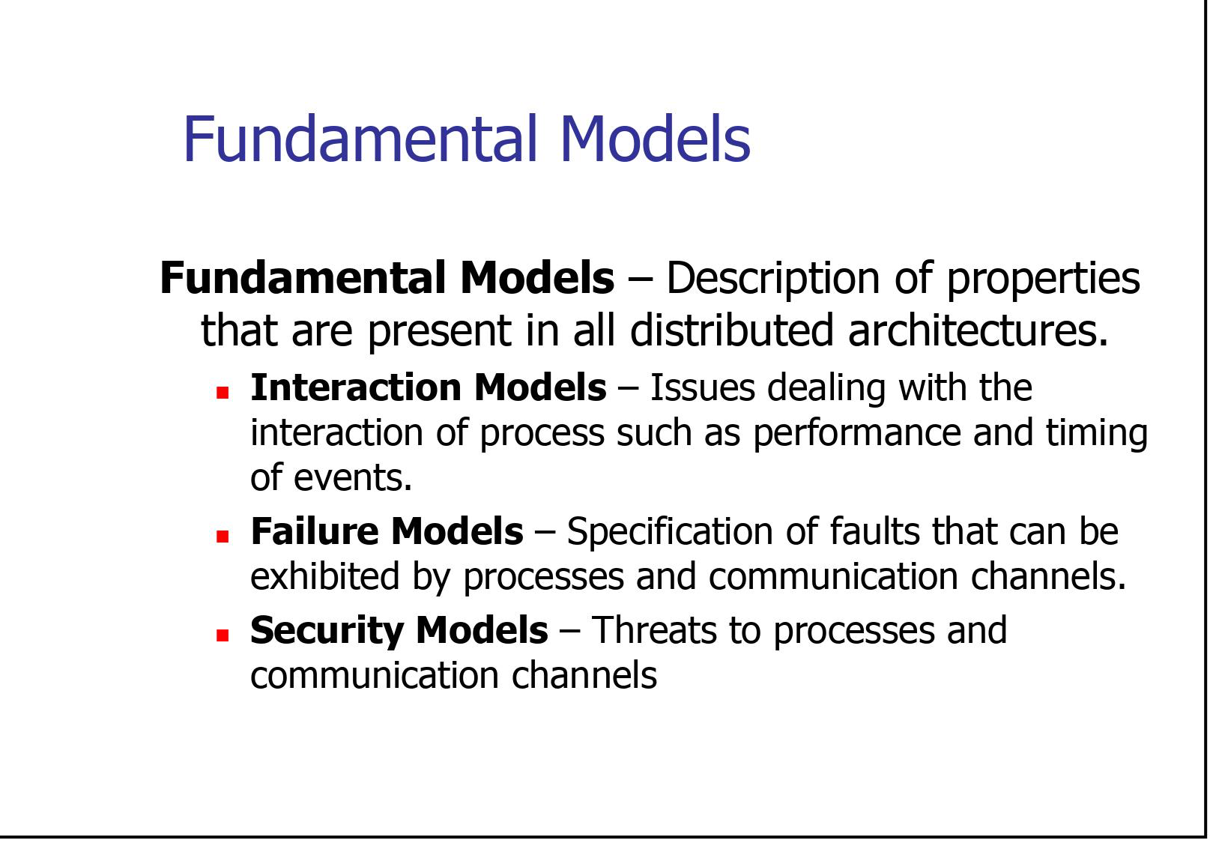

Slide 51
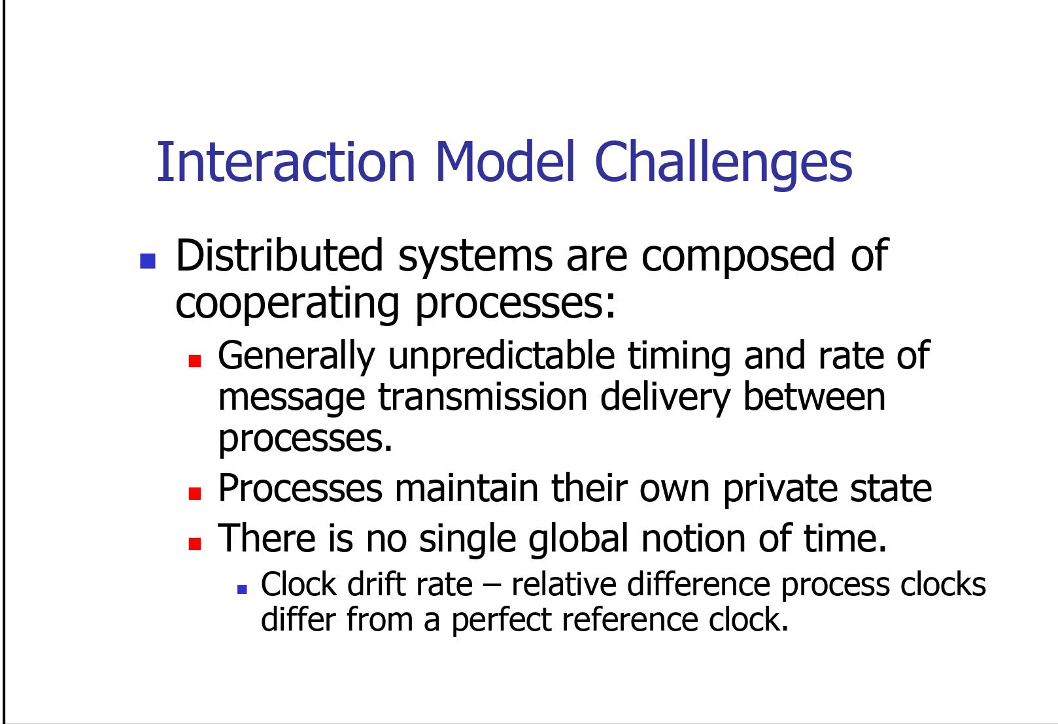

Slide 52
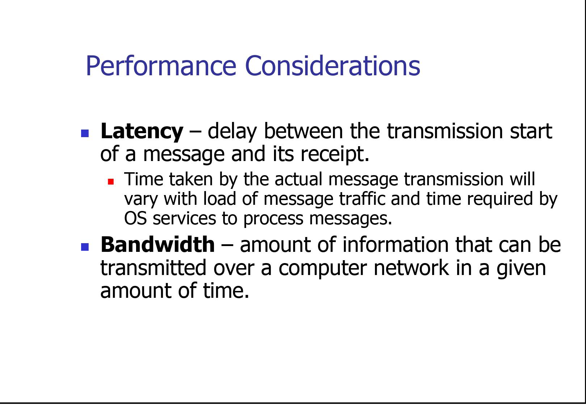

Slide 53
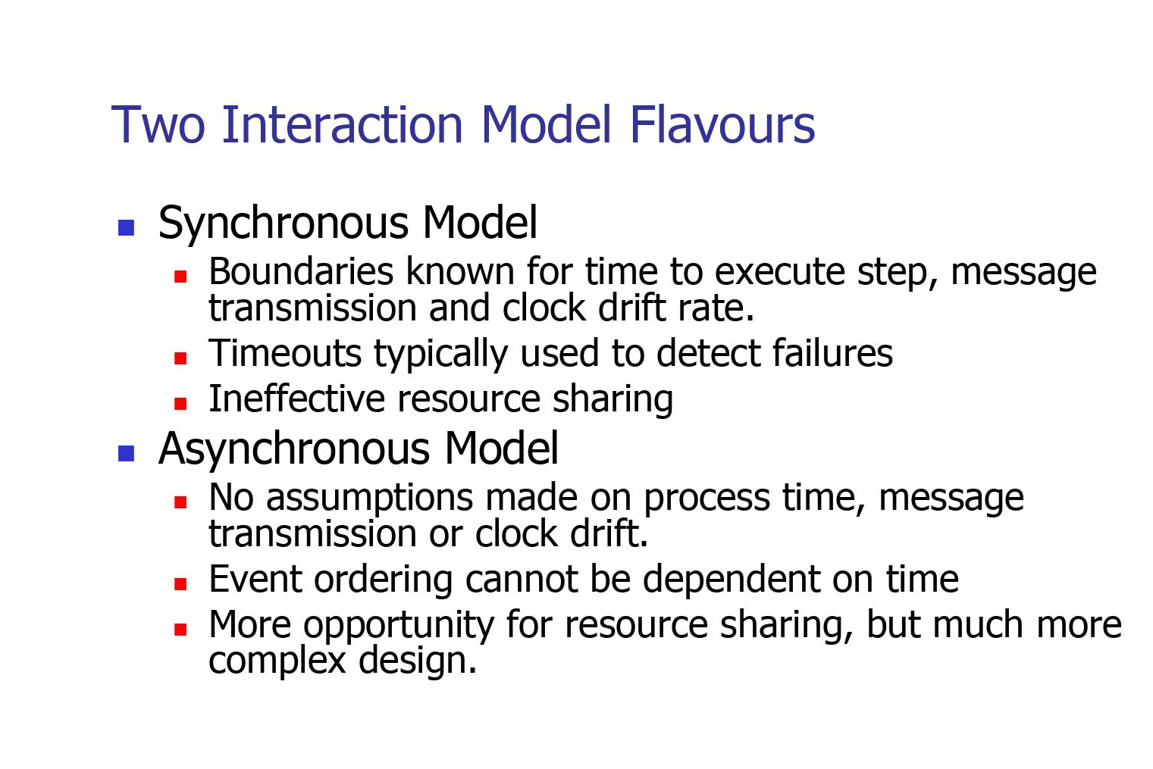

Slide 54
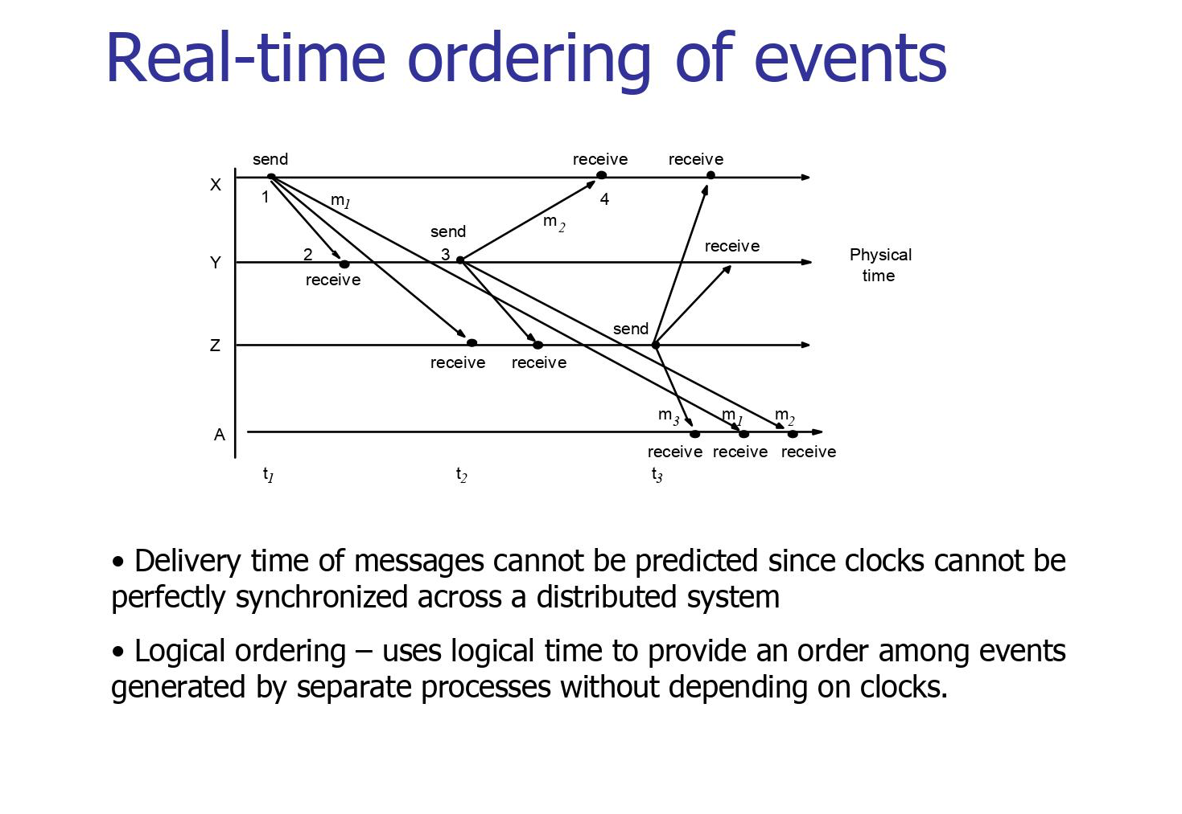

Slide 55
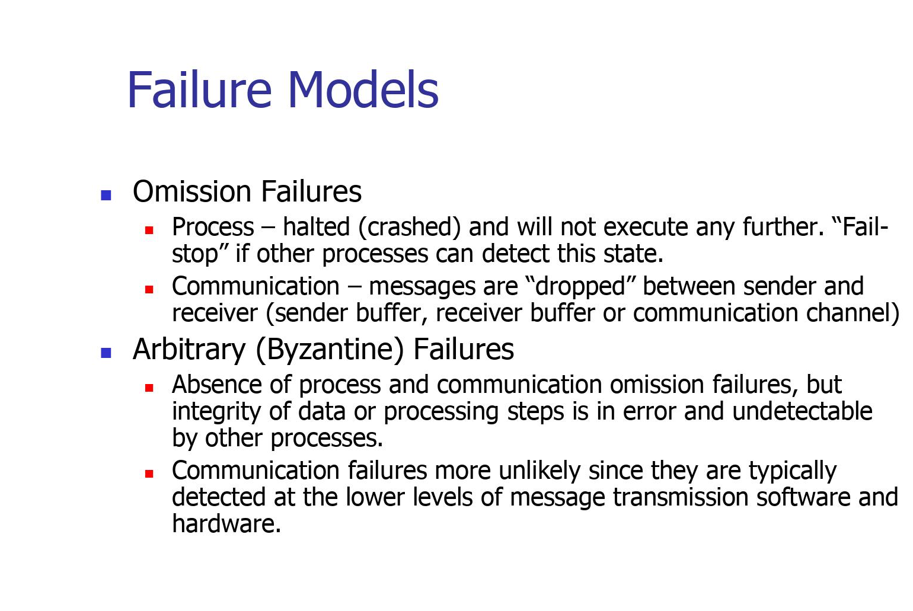

Slide 56
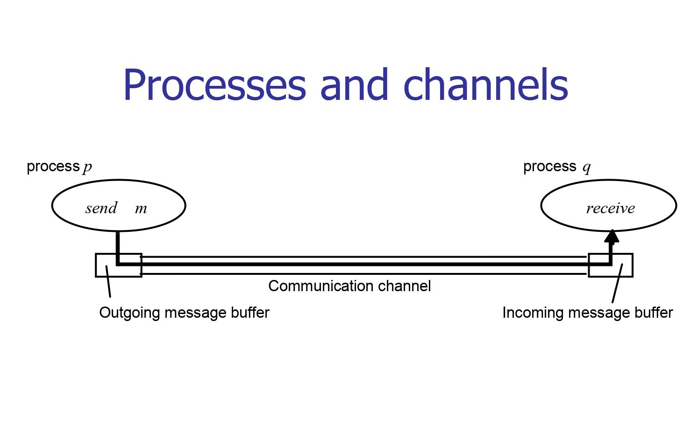

Slide 57
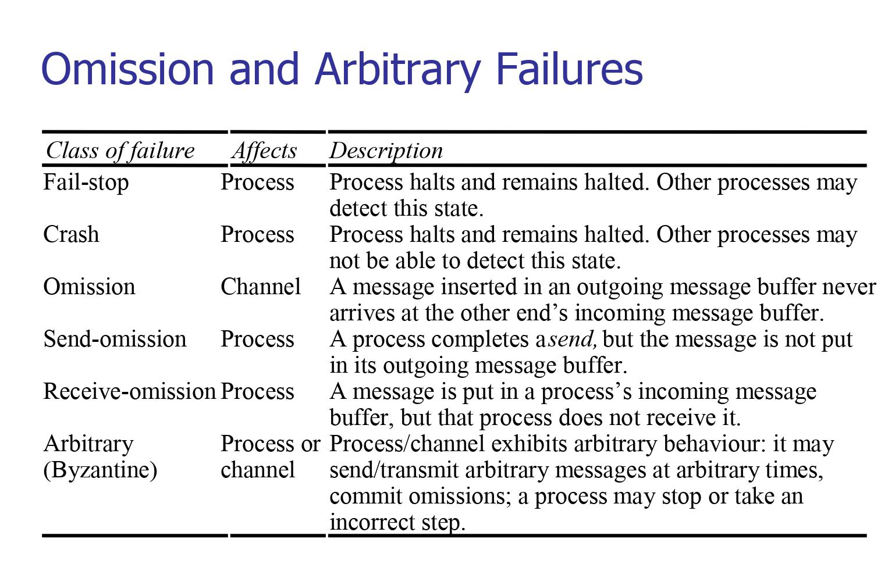

Slide 58
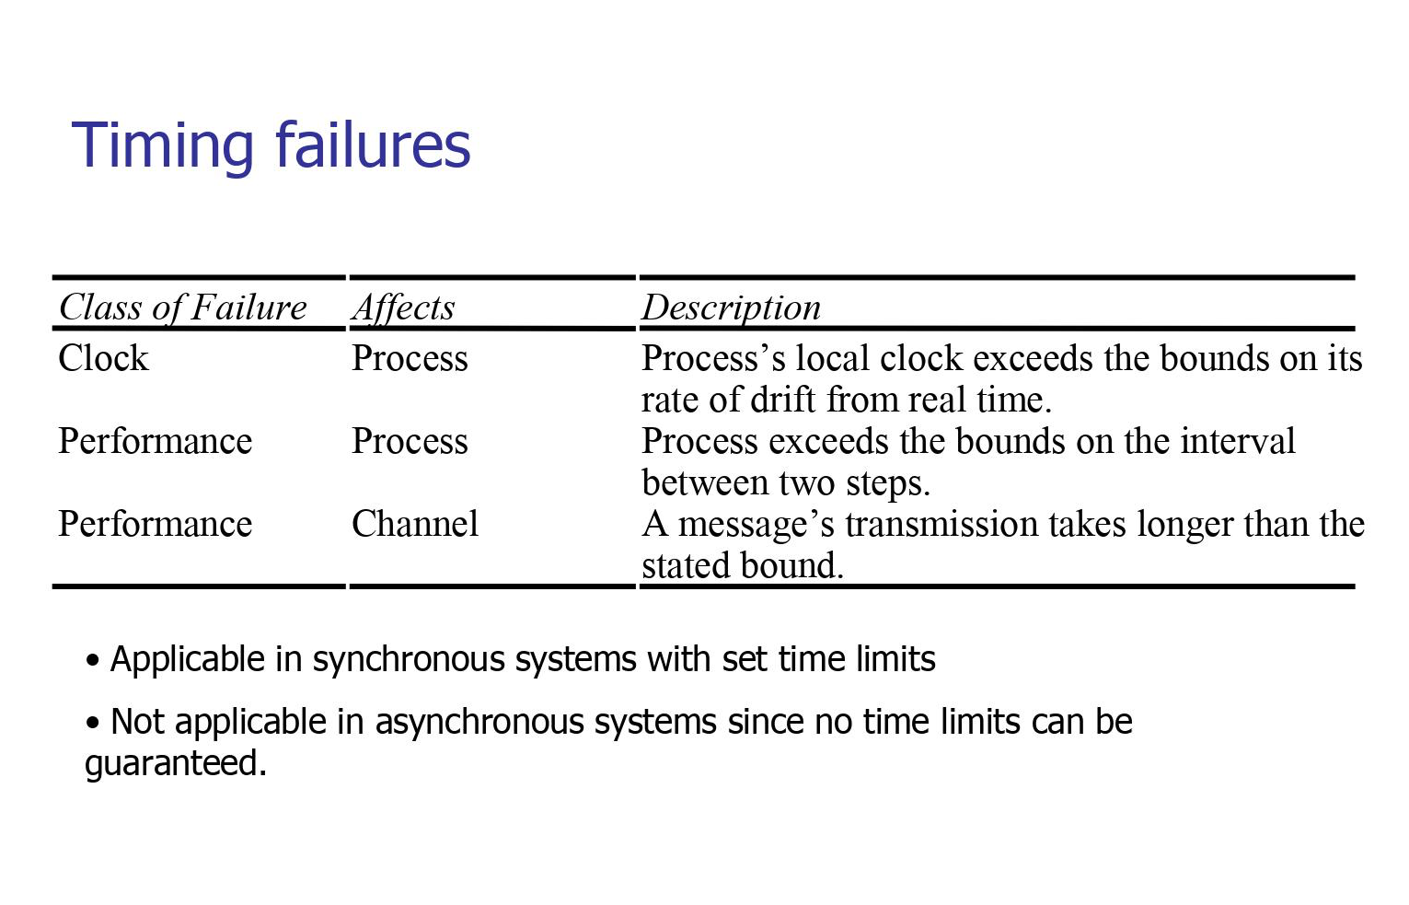

Slide 59
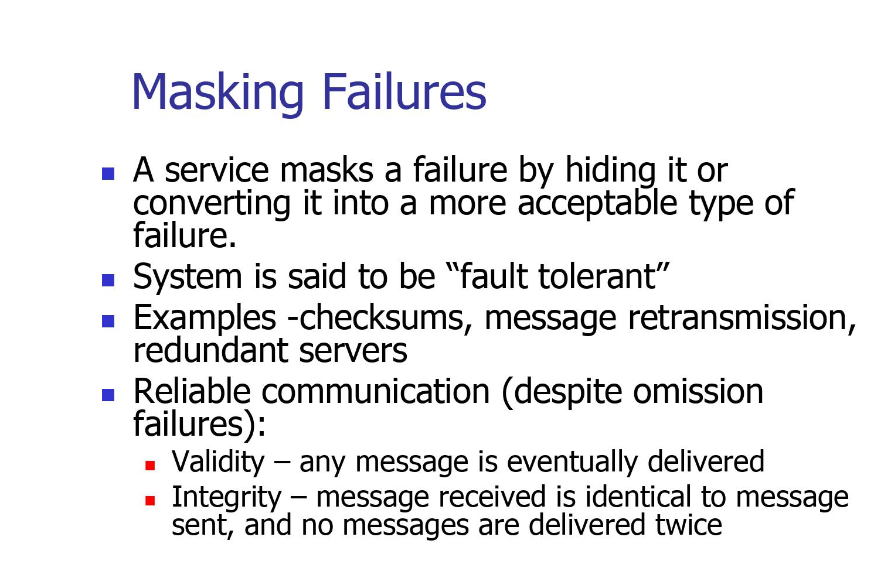

Slide 60
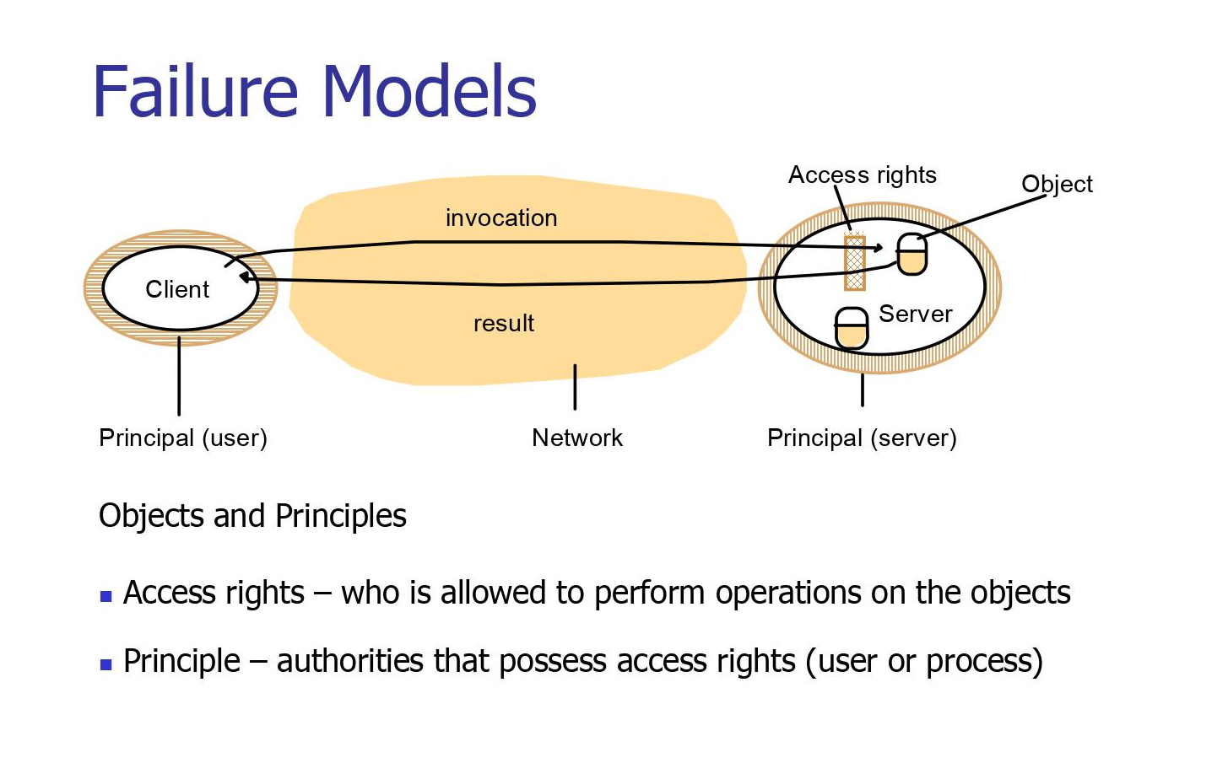

Slide 61
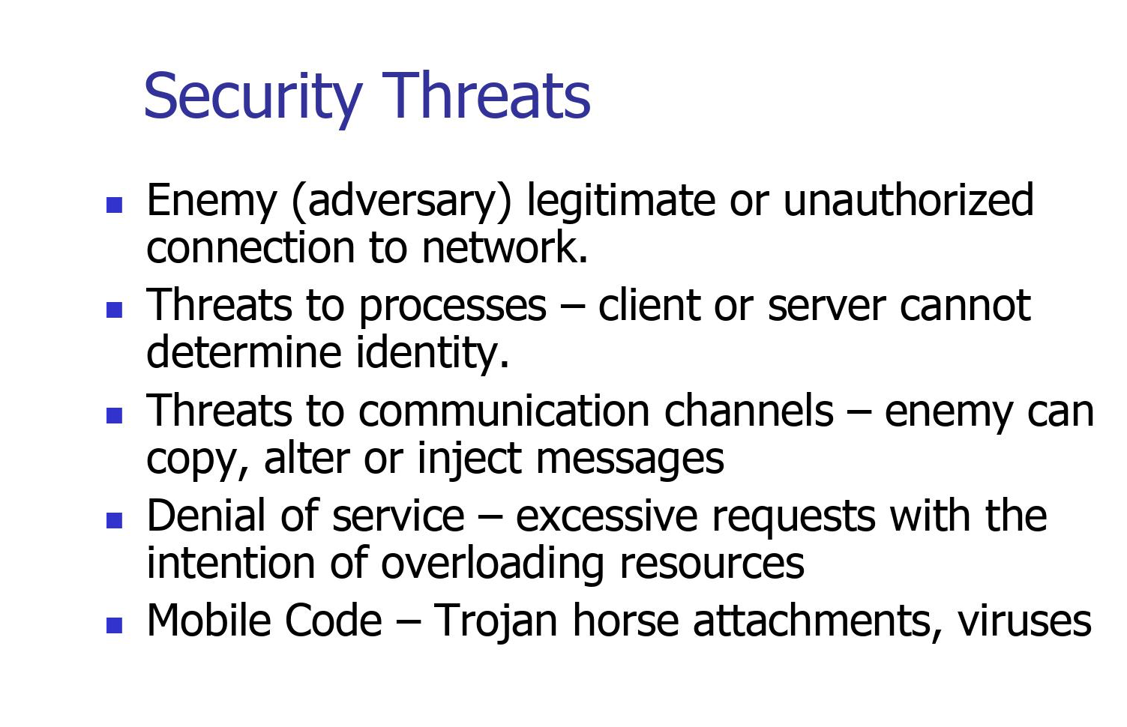

Slide 62
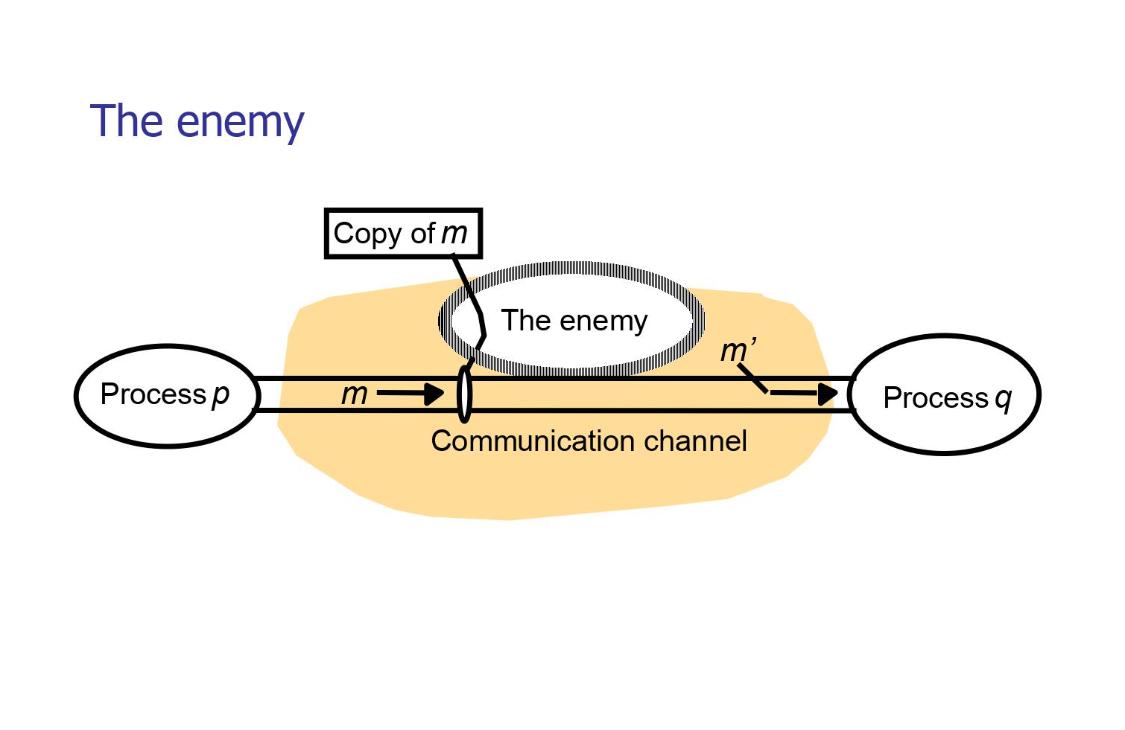

Slide 63
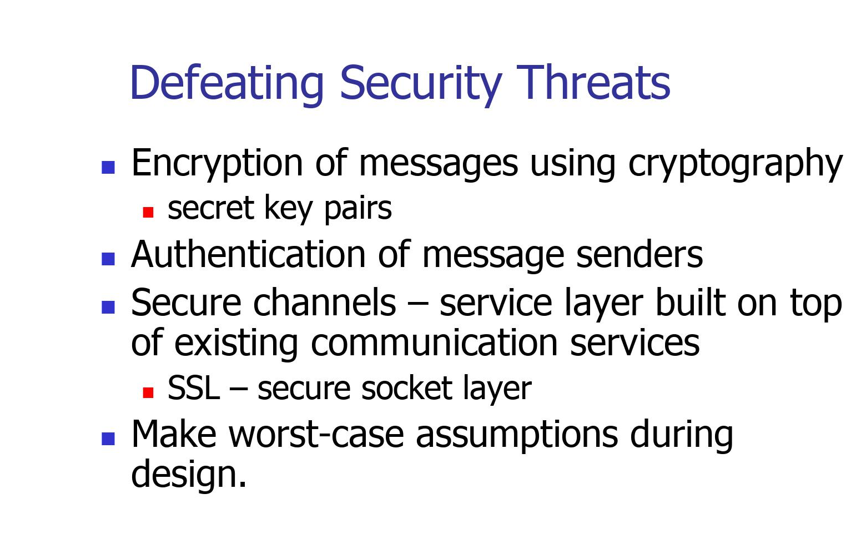

Slide 64
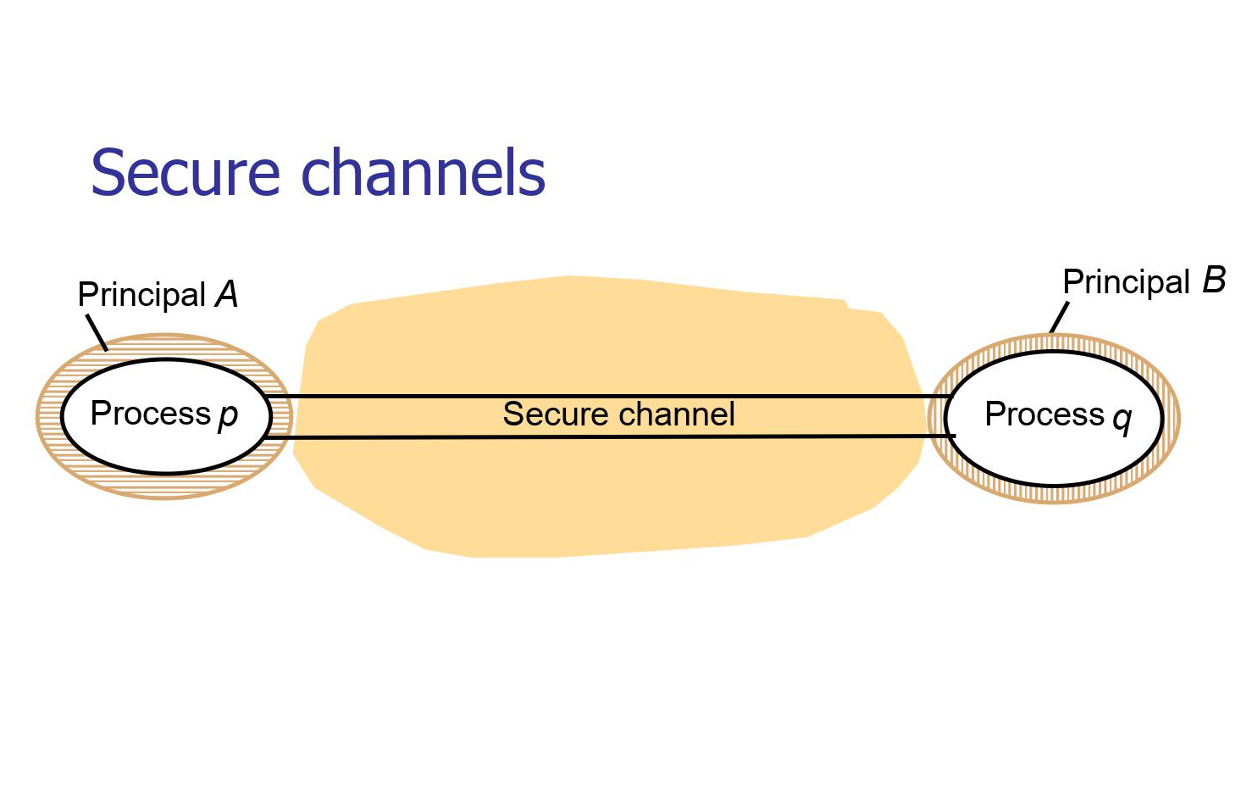

Slide 65
Summary
A distributed system is a network of independent computers that work together to achieve a common goal. Key characteristics include scalability, fault tolerance, heterogeneity, and concurrency. Distributed systems offer advantages such as resource sharing, reliability, improved performance, and flexibility. However, they also face challenges like communication delays, consistency maintenance, fault detection, and security concerns.
Architectural models include client-server, peer-to-peer, and hybrid approaches. Communication in distributed systems involves message passing, remote procedure calls (RPC), and publish-subscribe mechanisms. Use cases include distributed file systems (e.g., Hadoop Distributed File System) and distributed databases (e.g., Apache Cassandra, MongoDB).
Consistency models like eventual consistency, strong consistency, and causal consistency govern how distributed systems handle data coherence. Replication and load balancing are crucial for enhancing reliability and performance. Real-world case studies showcase distributed systems' applications, such as Google's infrastructure and Amazon Web Services.
Looking ahead, future trends in distributed systems include edge computing for reduced latency, blockchain and distributed ledgers for secure record-keeping, and serverless computing for executing functions without managing server infrastructure. In conclusion, distributed systems play a vital role in modern computing, offering a balance of advantages and challenges with ongoing innovations shaping their evolution.

Slide 66
QUIZ
1. A distributed system contains _____ nodes.
A. zero node
B. one node
C. two node
D. multiple node
2. All the nodes in distributed system communicate with each other and handle processes in tandem.
A. TRUE
B. FALSE
C. Can be true or false
D. Can not say
3. The nodes in the distributed systems can be arranged in the form of?
A. client/server systems
B. peer to peer systems
C. Both A and B
D. None of the above
4. In which system, tasks are equally divided between all the nodes?
A. client/server systems
B. peer to peer systems
C. user to client system
D. All of the above
5. Which of the following is not an Advantages of Distributed Systems?
A. All the nodes in the distributed system are connected to each other
B. It can be scaled as required
C. Failure of one node does not lead to the failure of the entire distributed system
D. Some messages and data can be lost in the network while moving from one node to another

Slide 67
REFERENCES
TEXT BOOKS
1. Cloud Computing: A Practical Approach by Toby Velte, Anthony Velte, Robert C. Elsenpeter, McGraw Hill Professional, 22 Oct 2009
2. Buyya, Rajkumar, James Broberg, and Andrzej M. Goscinski, eds. Cloud computing: Principles and paradigms. Vol. 87. John Wiley & Sons, 2010.
3. Miller, Michael. Cloud computing: Web-based applications that change the way you work and collaborate online. Que publishing, 2008.
4. Hurwitz, Judith S., et al. Cloud computing for dummies. John Wiley & Sons, 2010.
5. Kris Jamsa. Cloud Computing: SaaS, PaaS, IaaS, Virtualization, Business Models, Mobile, Security and more, Jones &Bartlet Learning Company LC, 20012
REFRENCE BOOKS
1. G. Pfister. In Search of Clusters. Prentice Hall PTR, NJ, 2nd Edition, NJ, 1998.
2. Cloud Computing: Implementation, Management, and Security, by John Rittinghouse and James F.Ransome, CRC Press Taylor and Francis Group
3. Joshy Joseph and Craig Fellenstein, Grid Computing, Person Edition, (2004).
4. Maozhen Li, Mark Baker, “The Grid Core Technologies”, John Wiley & Sons (2005).
5. Cloud Computing: A Practical Approach for Learning and Implementation Paperback – 1 January 2014 by Srinivasan, Pearson Education
Video Links
https://www.youtube.com/watch?v=A3FPxuKlnkU&list=PLFW6lRTa1g82dte3YD_7-GoZXcBiK6K9G
Web Links
https://www.geeksforgeeks.org/what-is-a-distributed-system/
https://www.geeksforgeeks.org/difference-between-cloud-computing-and-distributed-computing/
https://www.ibm.com/topics/distributed-cloud
https://www.geeksforgeeks.org/cloud-computing/
https://learn.rumie.org/jR/bytes/learn-the-basics-of-cloud-computing-in-3-minutes/?utm_source=bing&utm_medium=cpc&utm_campaign=RumieLearn-Bytes%20%28non-NA%29&utm_term=cloud%20computing&utm_content=TS%20-%20Computing%20In%20Cloud%20Computing

Slide 68

THANK YOU

